Slide 1
Generative Models
(Many figures adapted from Stanford CS231n, MIT 6.S191, and Illinois CS 498)

Slide 2
Outline
Introduction
Variational Autoencoders (VAEs)
Autoencoders
Generative Adversarial Networks (GANs)
Summary

Slide 3
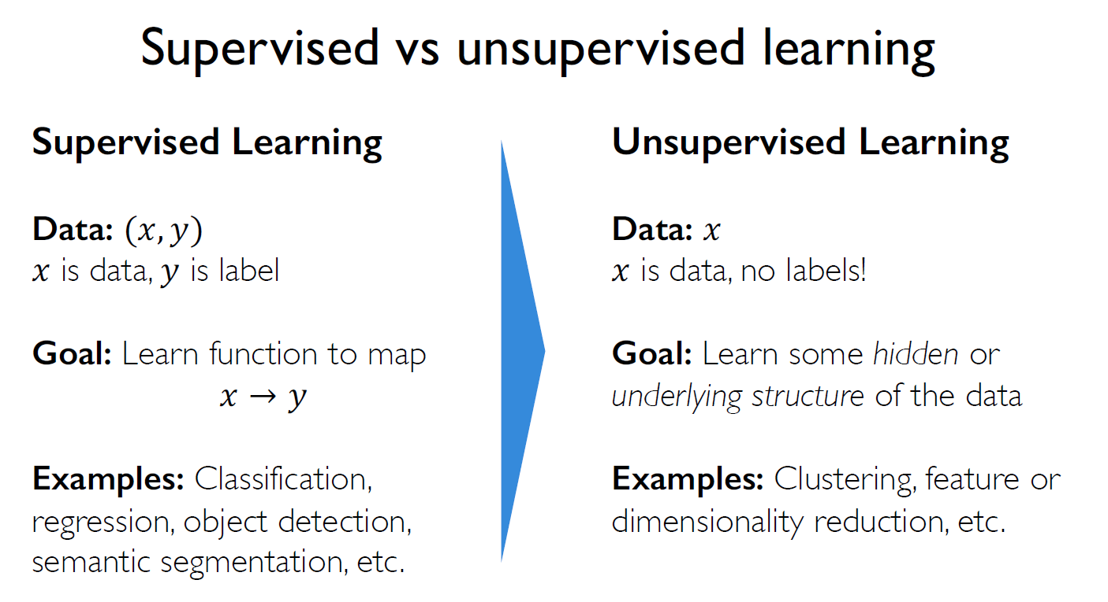
Introduction (1/3)

Slide 4







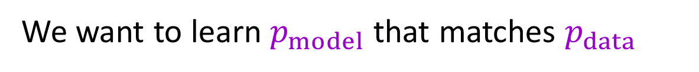

Introduction (2/3)
What are Generative Models?
Generative models are an Unsupervised Learning approach
Given training data, generate new samples from same distribution
Training data $x \sim p_{data}$
Generated samples $x \sim p_{model}$
learning
sampling
p (x)
model
We want to learn $p_{model}$ that matches $p_{data}$

Slide 5
Introduction (3/3)
Why generative models?
Debiasing
Outlier detection
and more…
Introduce two most popular types of generative models today
Variational Autoencoders (VAEs)
Generative Adversarial Networks (GANs)

Slide 6
Autoencoders: Background (1/7)
我沒有告訴他怎麼編碼，只是要求他從高維度變成低維度
低維度(好像資料的壓縮)
latent 隱藏、潛在

Slide 7
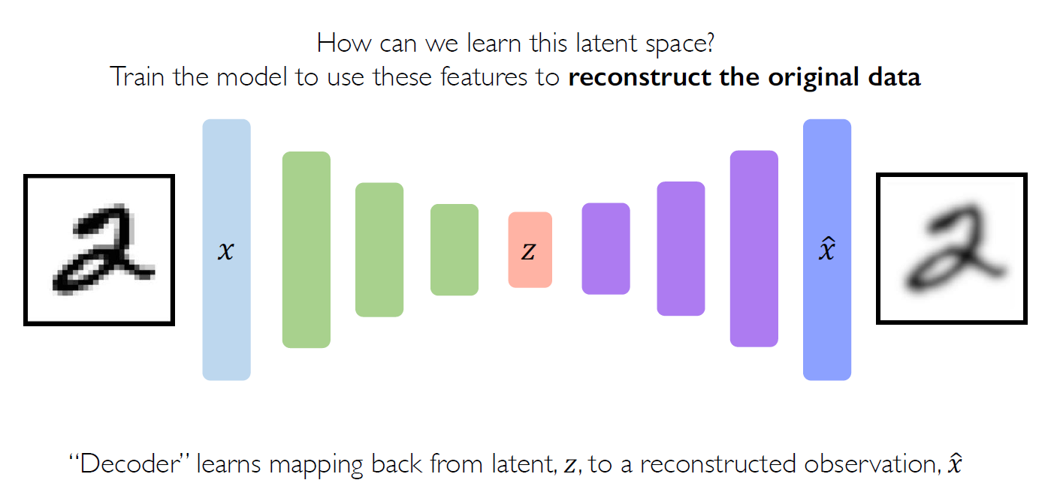
Autoencoders: Background (2/7)

Slide 8
Autoencoders: Background (3/7)

Slide 9
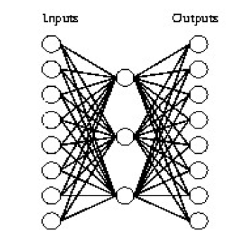
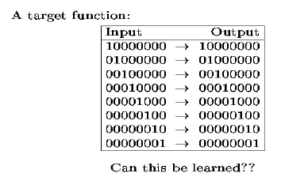
Autoencoders: Background (4/7)
Example 1: A 8 x 3 x 8 network was trained to learn the identity function

Slide 10
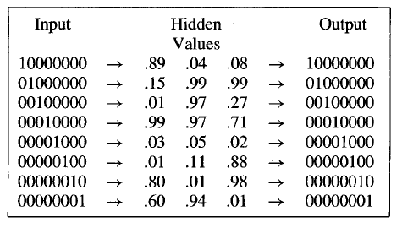
Autoencoders: Background (5/7)
Example 1: A 8 x 3 x 8 network was trained to learn the identity function
Notice that if the encoded values are rounded to zero or one, the result is the standard binary encoding for eight distinct values.
⇒ Eight input features reduce to three, and the low dimension features can reconstruct the original data.

Slide 11
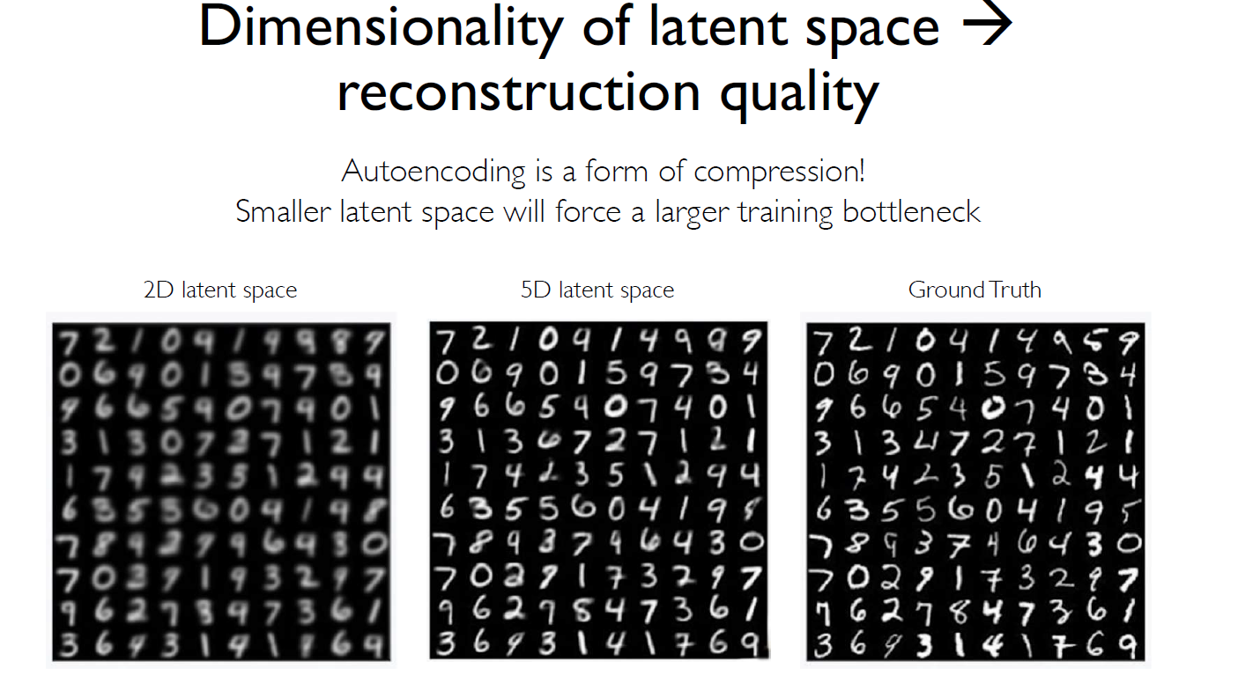
Autoencoders: Background (6/7)
Example 2: MNIST dataset

Slide 12
Autoencoders: Background (7/7)
Autoencoders Summary
Autoencoder = Encoder + Decoder (編碼器+解碼器)
Bottleneck hidden layer forces network to learn a compressed latent representation
Reconstruction loss forces the latent representation to capture (or encode) as much “information” about the data as possible
Training:
Inputs: original input X
Targets: original input X (X are Not Labels)
Application: Dimensionality reduction

Slide 13
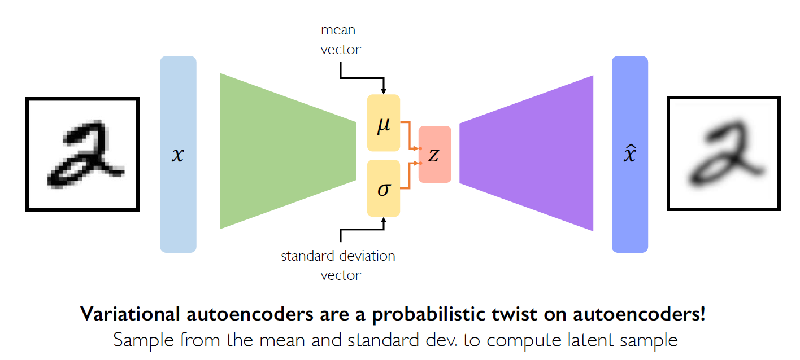
Variational Autoencoders (VAEs)
VAEs: key difference with traditional autoencoder

Slide 14
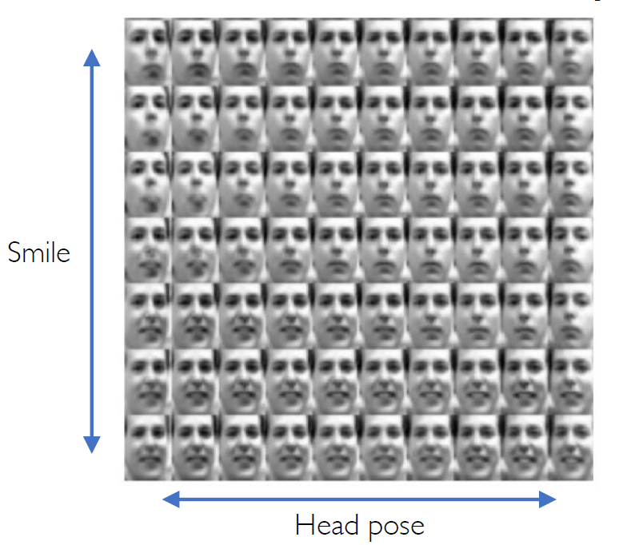
Variational Autoencoders (VAEs)
Variational Autoencoders: Generating Data!
Different dimensions of z encode interpretable factors of variation
Vary z₂
Vary z₁

Slide 15
Variational Autoencoders (VAEs)
VAEs Summary
Reparameterization trick to train end-to-end
Interpret hidden latent variables using perturbation
⇒ Generating new examples
Samples blurrier and lower quality compared to GANs

Slide 16
Generative Adversarial Networks (GANs) (1/2)
GANs are an approach to generative modeling using deep learning methods.
GANs consist of two neural networks that compete against each other during training.
The generator tries to generate realistic samples that have never been seen before.
The discriminator tries to identify whether its inputs are real or fake.

Slide 17
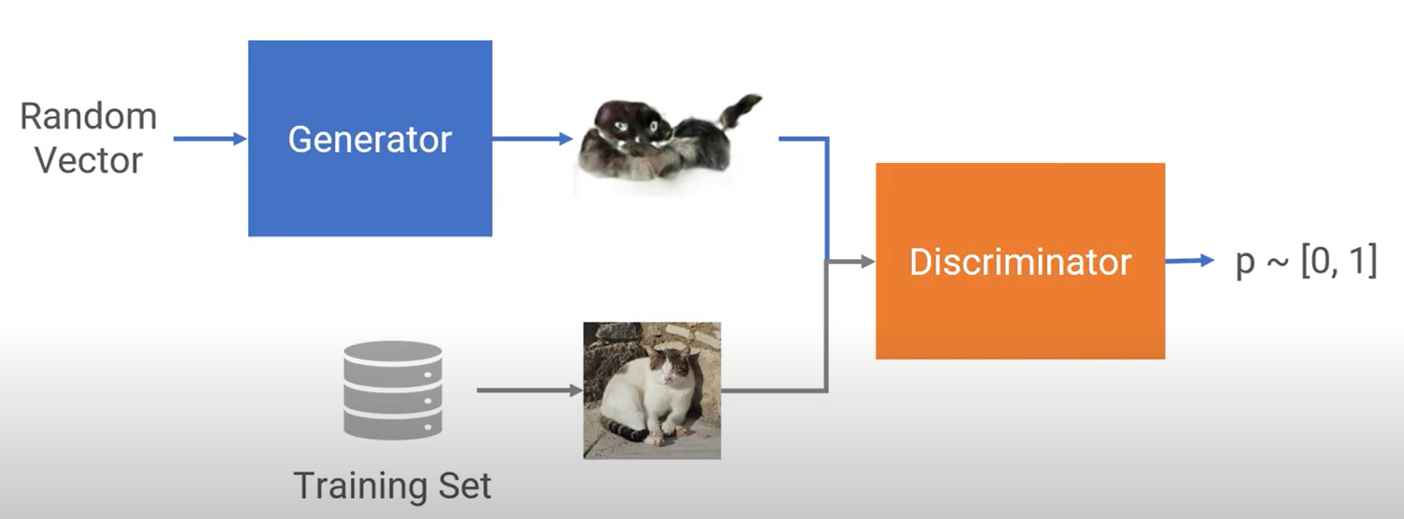
Generative Adversarial Networks (GANs) (2/2)
Train two networks with opposing objectives:
Generator: tries to fool the discriminator by generating real-looking samples
Discriminator: tries to distinguish between generated and real samples
壞人做偽鈔
警察抓偽鈔

Slide 18
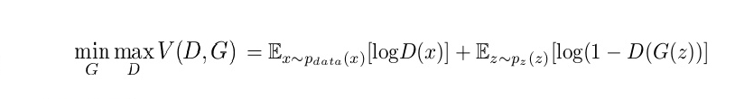
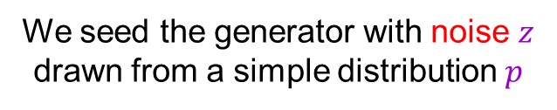

GAN objective
The discriminator $D(x)$ should output the probability that the sample $x$ is real
That is, we want $D(x)$ to be close to 1 for real data and close to 0 for fake
Expected conditional log likelihood for real and generated data:
We seed the generator with noise $z$ drawn from a simple distribution $p$

Slide 19
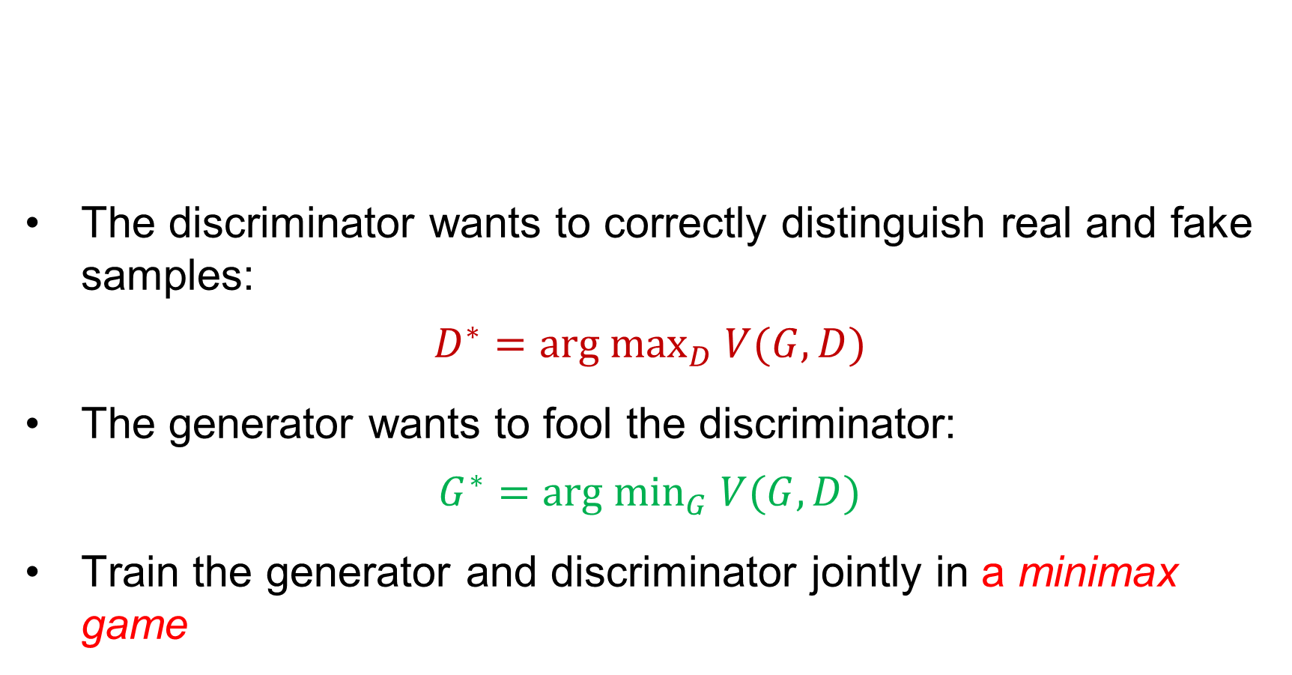
GAN objective
The discriminator wants to correctly distinguish real and fake samples:
$$D^{∗}={arg max}_{D} V(G,D)$$
The generator wants to fool the discriminator:
$$G^{∗}={arg min}_{G} V(G,D)$$
Train the generator and discriminator jointly in a minimax game
目標：最後讓警察覺得真鈔的機率是0.5
假鈔的機率是0.5

Slide 20
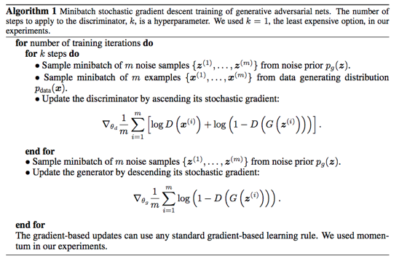
GAN Learning Algorithm

Slide 21
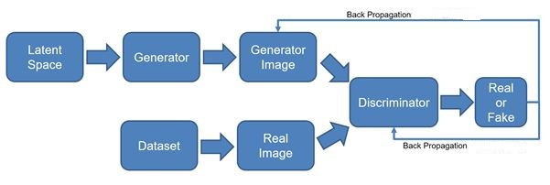
Training of GAN
Repeat the 2 steps:
Update the discriminator network;
Update the generator network.
21

Slide 22
Phase 1: Update the Discriminator
Train a classifier
Generate a batch of fake samples by the generator;
Randomly sample a batch of real samples;
Inputs: 𝐗 = [real_samples, fake_samples];
Targets: 𝐲 = [True, ⋯ , True, False, ⋯ , False];
Update the discriminator network using 𝐗 and 𝐲.
(freeze generator’s parameters)
Phase 2: Update the Generator
Connect the generator and discriminator
(freeze discriminator’s parameters).
22

Slide 23








GAN: Conceptual picture
Update discriminator
push $D(x_{data})$ close to 1 and $D\left(G(z)\right)$ close to 0
freeze generator’s parameters
$$G(z)$$
$$z$$
$$G$$
$$D$$
$$D\left(G(z)\right)$$
$$D(x_{data})$$
$$x_{data}$$

Slide 24






GAN: Conceptual picture
Update generator: increase $D\left(G(z)\right)$
Requires back-propagating through the composed generator-discriminator network
Freezes discriminator’s parameter
$$G(z)$$
$$z$$
$$G$$
$$D$$
$$D\left(G(z)\right)$$

Slide 25



GAN: Conceptual picture
Test time – the discriminator is discarded
$$z$$
$$G$$
$$G(z)$$

Slide 26
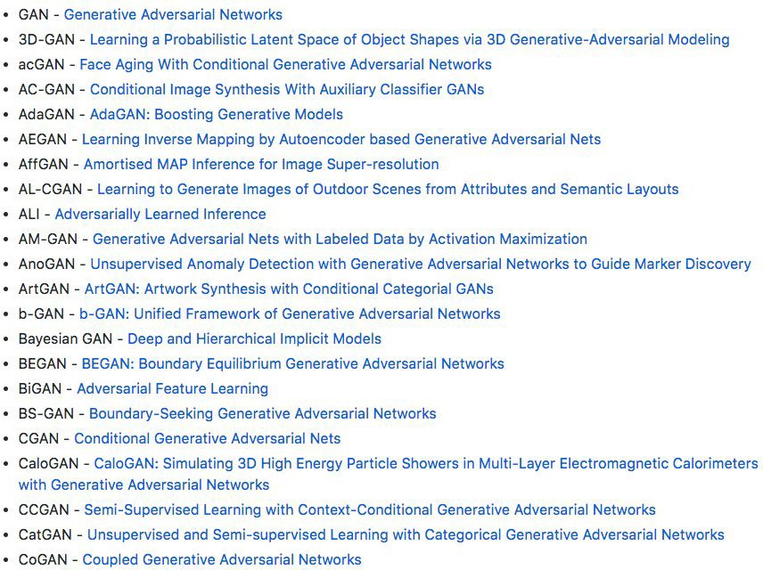
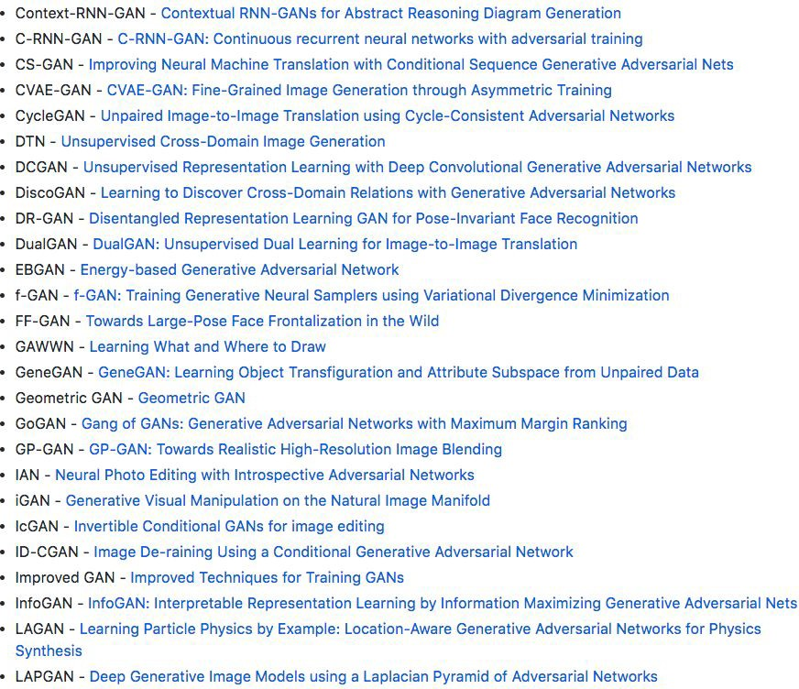
_{2017: Explosion of GANs} See also: https://github.com/soumith/ganhacks for tips
and tricks for trainings GANs
“The GAN Zoo”
https://github.com/hindupuravinash/the-gan-zoo
Lecture 11 -
26

Slide 27
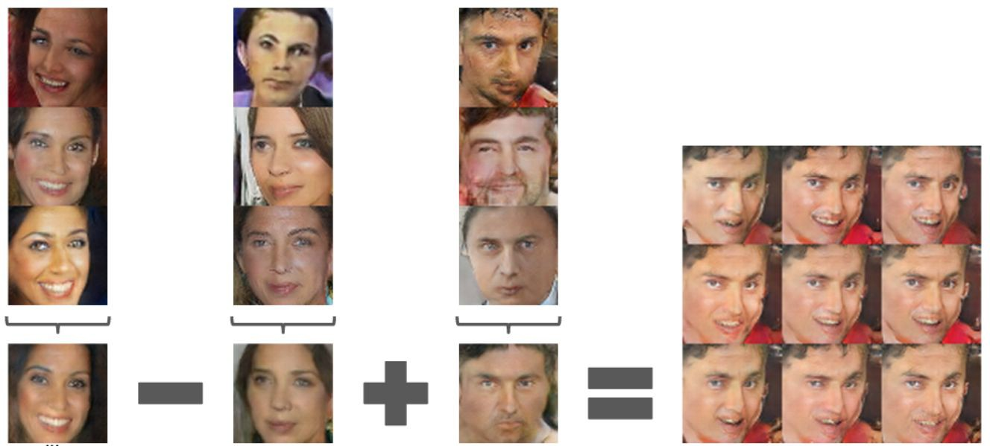
Generative Adversarial Nets: Interpretable Vector Math
Smiling woman Neutral woman Neutral man
Radford et al, ICLR 2016
Smiling Man
Samples from the model
Average Z vectors, do arithmetic
Lecture 11 -
27

Slide 28
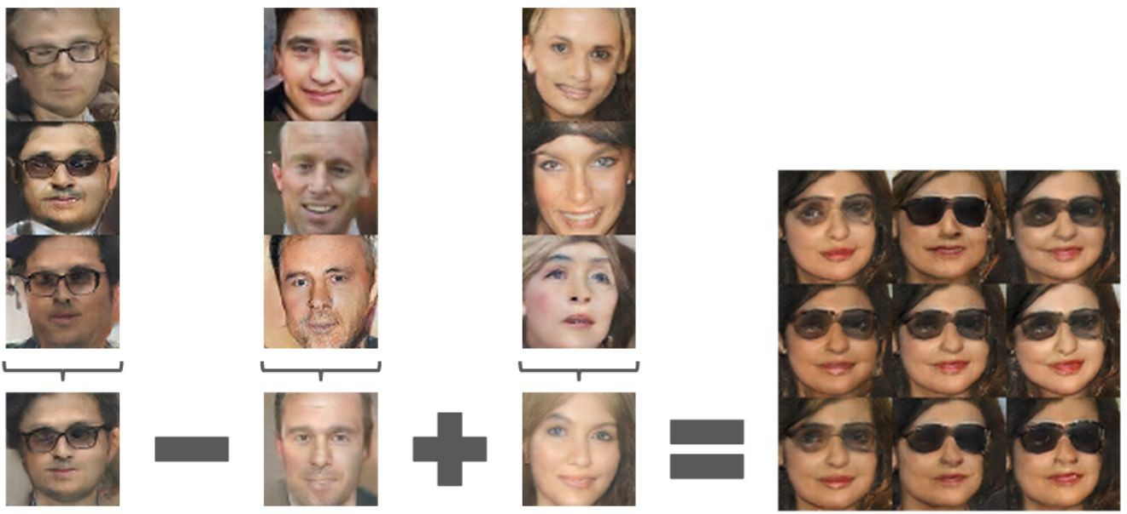
Generative Adversarial Nets: Interpretable Vector Math
Glasses man No glasses man No glasses woman
Radford et al, ICLR 2016
Woman with glasses
Lecture 11 -
28

Slide 29
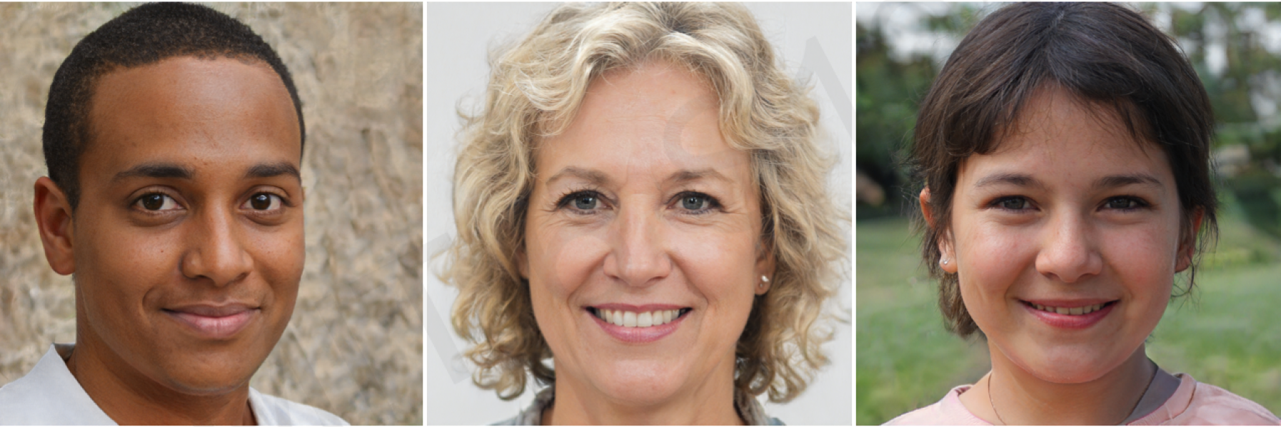
Which face is fake?

Slide 30
Generative Models: Summary
Autoencoders and Variational Autoencoders (VAEs)
Learn lower-dimensional latent space and sample to generate input reconstructions
Generative Adversarial Networks (GANs)
Competing generator and
discriminator networks
VAEs: Explicit density method
GANs: Implicit density method

Slide 31
Resources
Stanford CS231n: Convolutional Neural Networks for Visual Recognition
MIT 6.S191: Introduction to Deep Learning
Illinois CS 498: Introduction to Deep Learning

